Slide 1
Breast Cancer Prediction

Slide 2
Guide name: Dr. A Sampath Kumar
Made By:
Vedant Anand (19BAI10130)
Pratham Kurele (19BAI10163)
Manan Mittal (19BAI10171)
Devansh Rathi (19BAI10173)

Slide 3
According to the World Health Organization, breast cancer is the most commonly diagnosed cancer and is the leading cause of cancer deaths among women worldwide. On average, a woman is diagnosed with breast cancer every two minutes and one woman dies of it every 13 minutes worldwide.¹ In 2019, an estimated 268,600 new cases of invasive breast cancer are expected to be diagnosed in women in the U.S. alone, along with 62,960 new cases of noninvasive (in situ) breast cancer,^{2,3,4} with about 41,760 mortalities.
Automatic detection of diagnostically relevant regions- of-interest reduces the pathologist’s workload while also assuring that no critical region is overlooked.
Introduction

Slide 4
The existing work has only a few limitations, which are:
High speed internet connection.
It won’t be able to tell the stage of the cancer.
The model won’t be able to predict the upcoming state of the cancer
Existing work with limitations

Slide 5
Proposed work and Methodology
The purpose of the work is to optimise the list of data transformations and machine learning algorithms to accomplish the classification transformation.
The implementation of pipelines is based to supervised models from scikit-learn library.The number of kernels function is chosen randomly.
In this work, many applied techniques were tested for the subsequent stages of processing and analysis of the breast cancer dataset.

Slide 6
Stage 1 : Preprocessing
As a part of this research, processing was performed on the raw breast cancer data to scale the features using the Standard Scaler module. Standardisation of datasets is a common requirement for many machine learning estimators.
In this we have taken the standard mean of the data given to us and predict that breast cancer is present or not.
If the accuracy is more than 90% or 0.9, then we will say that it is successful result and we will take the method which has more accuracy.

Slide 7
Stage 2 : Feature Selection
Usually, feature selection is applied as a preprocessing step before the actual learning. However, no algorithm can make good predictions without informative and discriminative features; therefore, to keep the most significant features and reduce the size of the dataset, we implemented PCA using randomised SVD.
We have removed some rows and column to make our dataset short and accurate

Slide 8
Stage 3 : Machine Learning Algorithm
Usually, ensemble machine learning algorithms allow better predictive performance compared with a single model. This can be considered machine learning competition, where the winning solution was used as a model for breast cancer diagnosis.
We have used three types of machine learning models to give the desired output
1- Logistic regression method
2- Decision tree classifier
3- Random forest classifier method

Slide 9
Result
We will get the desired output from all the methods suggested above , but Logistic regression method has the highest accuracy

Slide 10
Novelty of the project
The early detection of breast cancer in women is important for the effective management of the disease.
Main advantage of early detection is that it provides the best chance of effective treatment.
The aim with the prediction algorithm is to reduce the chances of getting faulty results during the detection of the disease at an earlier stage.

Slide 11
Real time Usage
The realtime usage of method for breast cancer detection is to find an easy way to detect the disease and thus help cure the disease at an earlier stage which can reduce financial stress and stop health from deteriorating further.

Slide 12
Hardware & Software requirement
Hardware
A computer system and internet access.
Software
Dataset, python installed compiler with proper libraries.

Slide 13
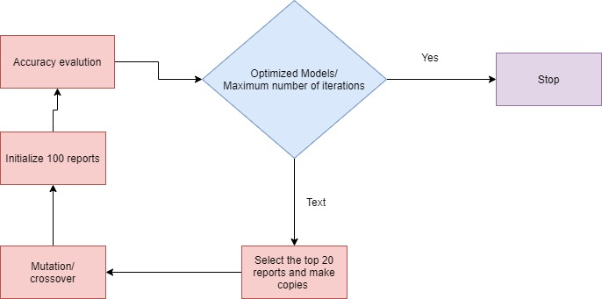
Overall system architecture diagram

Slide 14
Literature Review
Breast cancer (BC) is one of the most common cancers among women worldwide, representing the majority of new cancer cases and cancer-related deaths according to global statistics, making it a significant public health problem in today’s society.
This research is done by the MIT and because of the research in Machine Learning and Deep Learning.
We obtain this training model and because of this model we can predict the breast cancer in women.
This trains a neural network model to compare the Tissue and cells of a patient and a normal person . It's okay if you don't understand all the details; this is a fast-paced overview of a complete Tensor Flow program with the details explained.

Slide 15
The following steps are followed
Step 1: Start with Python compiler
Step 2: Import Dataset
Step 3: Explore the data
Step 4: Preprocess the data
Step 5: Build the model
Step 6: Train the model
Step 7: Use the Trained model
Step 8: Stop

Slide 16
Module Description
First we will start the compiler and them we will import the dataset which helps us in making the project. Then we will import the kerels which is important to build and train the model. Then we will pre-process the data which we have to classify and then we have built the model in a way in which it can divide the images into pixels and then we compare each pixel to the infected tissue and then train the model to recognize the image and if again it encounter then it is easy to for computer to distinguish and give effective results
Then it will give the results that are shown by the program and hence our answer is there.

Slide 17
Module work flow Explanation
Importing breast cancer dataset from Kaggle
The Dataset we have used here is the dataset of Wisconsin which help us predict whether the cancer is benign and malignant.
Explore the data
We have divided the dataset into two parts that is benign and malignant.
Malignant is represented by 0 whereas benign is represented by 1.
After dividing we have checked the concentration of the tissue to determine whether it is contaminated or not . By this comparison we will predict the accuracy whether a group of women has breast cancer or not.

Slide 18
3. Preprocess the data
The data must be preprocessed before training the network. If you inspect the first image (tissue) in the training set, you will see that the pixel values fall in the range 0 to 255.
4. Applying the algorithm
We have used Base line Algorithm and it consist of decision tree classifier, SVC, Gaussian NB, K-Neighbour Classifier. By using these algorithm in SVM we will predict the accuracy of the given dataset
5. Using the Dataset
With this algorithm we can save time of the doctors and the patient in the fast detection of breast cancer and solve it as soon as possible to minimise the risk of the death.

Slide 19
Result and Discussion
In this project in python, we learned to build a breast cancer tumour predictor on the wisconsin dataset and created graphs and results for the same. It has been observed that a good dataset provides better accuracy. Selection of appropriate algorithms with good home dataset will lead to the development of prediction systems. These systems can assist in proper treatment methods for a patient diagnosed with breast cancer. There are many treatments for a patient based on breast cancer stage; data mining and machine learning can be a very good help in deciding the line of treatment to be followed by extracting knowledge from such suitable databases.

Slide 20
Conclusion
The Success ratios is only 90-95% sometimes it is above 90% because of the similar images.
The Pixel of few images is very similar when it comes to the tissue so it is very difficult to distinguish between them.
The success rate of this Almost 95% and sometimes it becomes very effective and give success rate 99%.
We cannot fully predict whether a women is having Brest cancer or not because of the different varieties of tissues and difference in genes

Slide 21
THANK YOU

